Slide 1
Hotpot in Asia
Presentor: Liyao Ma

Slide 2
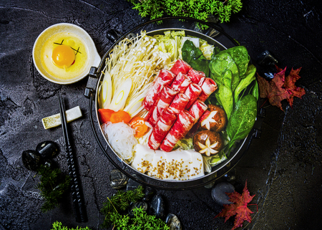
What is Hotpot?
Hotpot is best defined as a cooking mechanism which involves the process of boiling raw or uncooked food in a pot of soup stock.

Slide 3
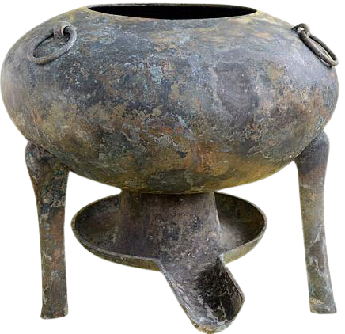
Brief History
Hotpot originated in China and can trace back at least 1700 years ago. It was not until the 14th century when emperors from the Ming and then Qing dynasties made this cooking method popular and gradually formed the hotpot we know today.
Picture on the left shows one of the earliest prototypes of a hotpot.

Slide 4
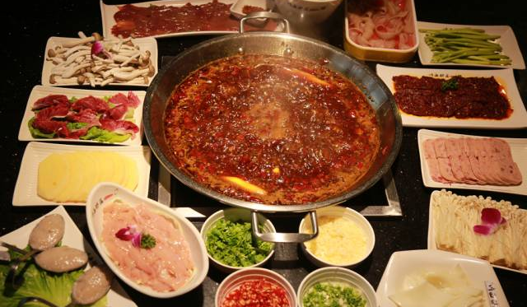
Hotpot in China
Different regions across China are known for completely different styles of hotpot. The most typical ones include Chongqing hotpot, known for its numbness and spicy taste; and Beijing hotpot, known for its tasteless soup stock and well-sliced lamb.

Slide 5
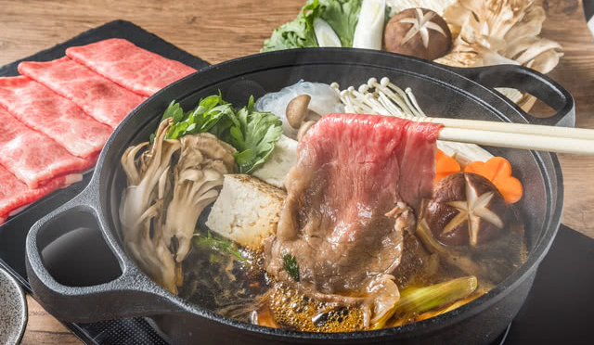
Hotpot in Japan
The most popular style of hotpot in Japan is Sukiyaki, known for its sweet and salty soup base along with well-sliced beef and mixed vegetables, commonly served with raw, beaten eggs.

Slide 6
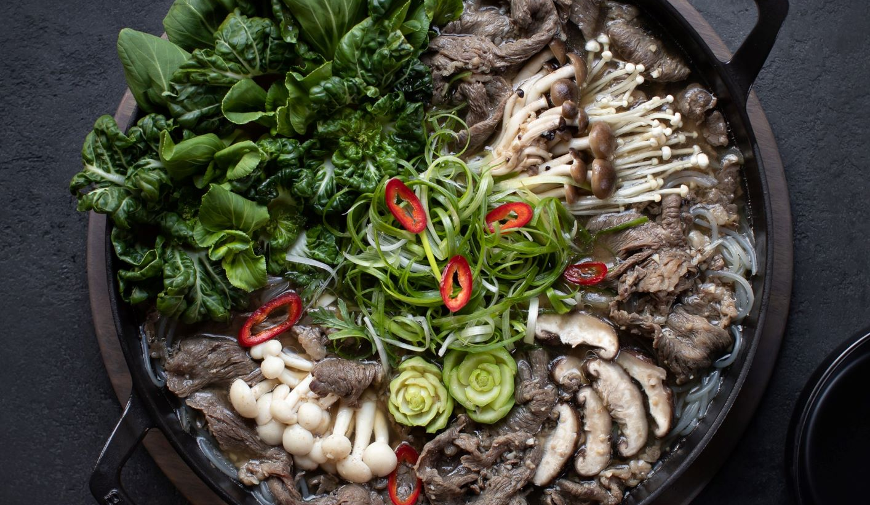
Hotpot in South Korea
Korean hotpot commonly takes form as Jeongol, which emphasis on ingredients such as mushroom and seafood. Korean Gochujang acts as one of the well-known sources of seasoning for this type of hotpot.
Notes:
Korean Jeongol separates from other famous Korean soup dishes with its less salty soup base and its way of cooking continuously throughout the course a meal (similar to Chinese and Japanese-style hotpots).

Slide 7
REFERENCES
https://www.bibigousa.com/products/recipes/bulgogi-jeongol/
https://guide.michelin.com/sg/en/article/features/korean-soups-guk-tang-jjigae-jeongol-sg
https://savorjapan.com/contents/discover-oishii-japan/the-complete-guide-to-nabe-a-staple-japanese-winter-food/
https://en.wikipedia.org/wiki/Hot_pot
https://frayedpassport.com/all-about-hot-pot-history-styles-where-to-eat-it-recipes-more/
https://www.123rf.com/stock-photo/hotpot.html?sti=ma6h73n1upyu9fvfbz|
Free licensed images taken from https://unsplash.com/

Slide 8
THANKS!
liyaoma@uvic.ca
leom-edu.opened.ca
Please keep this slide for attribution.

