Slide 1
Patient Portal
Anna Wang & Liyao Ma

Slide 2
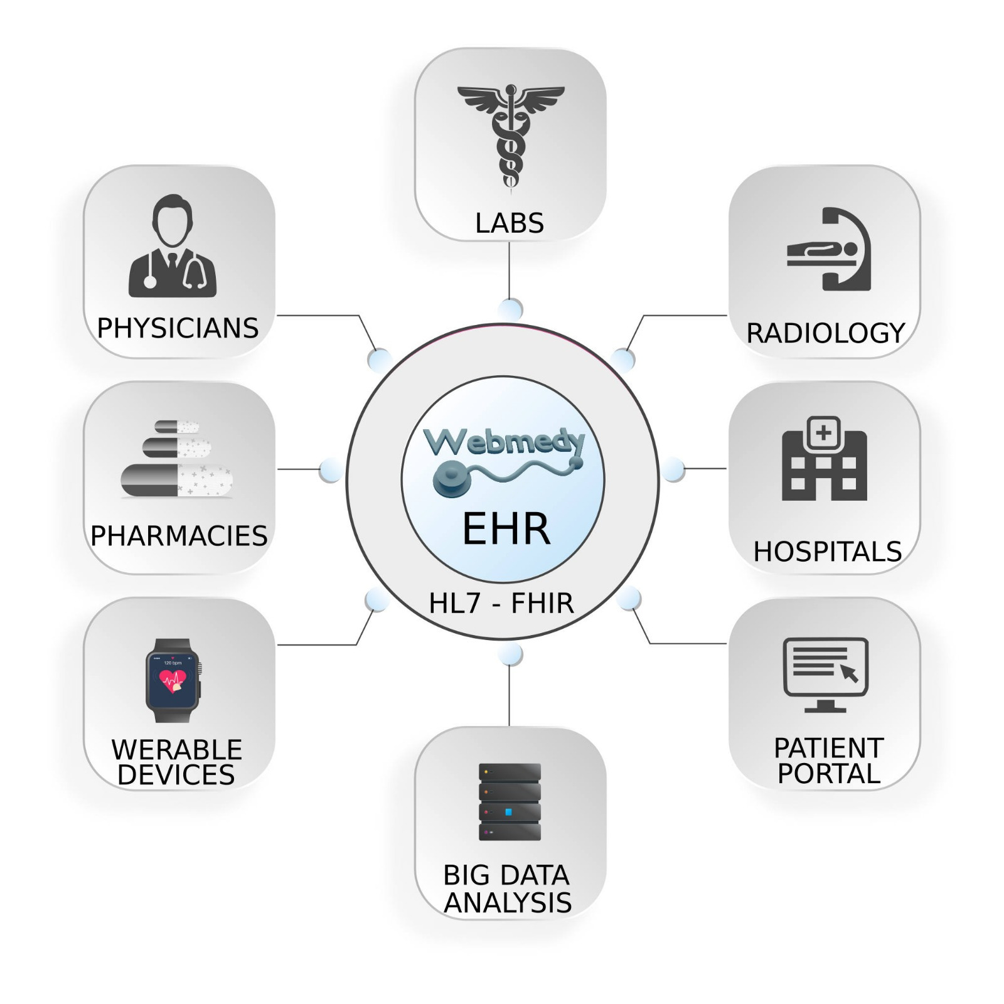
Electronic Health Record (EHR)
EHR is a digital version of a patient’s paper chart that record health information.
Key features
Patient-centered
Improve care coordination
Portable and easy to share across organizations

Slide 3
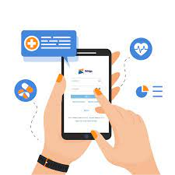
Patient Portal and EHR
Patient Portal is:
A module of EHR
Promote patient engagement
Improve patient communication with care providers

Slide 4
BC Patient Portals
Ministry of Health - Health Gateway
Island Health - MyHealth
Fraser Health - MyChart

Slide 5
BC Health Gateway
Available information
Currently:
Medical information
Health Record
COVID-19 test results
COVID-19 immunization digital card
Future:
laboratory test results
diagnostic imaging reports

Slide 6
BC Health Gateway
Available for:
12 and older British Columbians
Mobile BC Services Card
mobile device
Registration:
Go to Health Gateway Website
Log in with mobile BC Services Card
Set up profile
Verify contact information
Detail registration process see BC Government Health Gateway Website

Slide 7
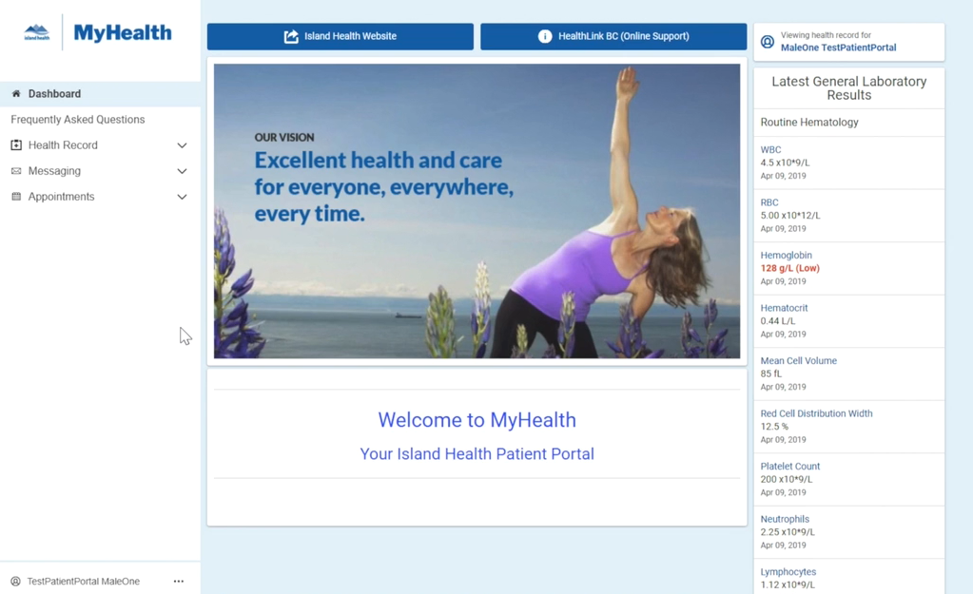
Island Health - MyHealth
Available information
Laboratory results
Microbiology
Pathology
Imaging reports
Appointments
Print reports
Video introducing MyHealth

Slide 8
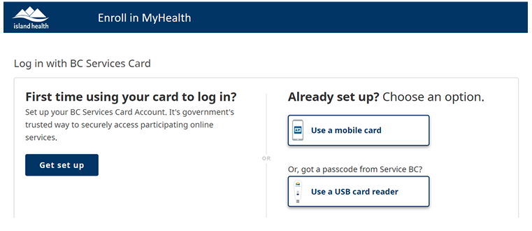
Island Health - MyHealth
Available for:
19 years and older
Received services from an Island Health location
Registration:
By Phone 1-844-844-2219
In-person
Enroll Online
Request Access to Other’s Account
Online Enrollment:
Set-up Mobile BC Service Card
Complete Online Enrollment Form
Confirm Account
Detail process see Enroll MyHealth

Slide 9
Fraser Health - MyChart
Available Information:
Fraser Health records
Patient education materials
Manage appointments
https://youtu.be/HlitGjPpxMI

Slide 10
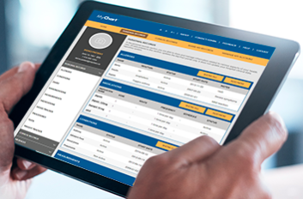
Fraser Health - MyChart
Available for:
19 years and older
Fraser Health patients
Registration:
In-person
Electronically
Online Enrollment:
Obtain MyChart consent form
Receive PIN from email
Go to http://www.fraserhealth.ca/mychart
Log in
BC Service Card information
Profile information
Detail Guide: How To Register for MyChart™

Slide 11
Thanks For Watching!
Notes:
Thank you for watching this presentation and hope you find this information helpful

Slide 12
References
https://www.healthlinkbc.ca/health-topics/abo4950
https://www.healthit.gov/faq/what-electronic-health-record-ehr
https://www.islandhealth.ca/sites/default/files/2019-12/myhealth-brochure_0.pdf
https://www2.gov.bc.ca/gov/content/health/managing-your-health/health-gateway#health-info
https://www.healthgateway.gov.bc.ca/
https://www2.gov.bc.ca/gov/content/covid-19/vaccine/plan
https://vimeo.com/showcase/6558209/video/371505623
https://www.fraserhealth.ca/patients-and-visitors/mychart-patient-portal/register-for-mychart#.YMi1Megza01
https://www.fraserhealth.ca/patients-and-visitors/mychart-patient-portal/mychart-information-and-education-for-patients/mychart-videos#.YMixkegza01
https://www.fraserhealth.ca/-/media/Project/FraserHealth/FraserHealth/Patients-and-Visitors/_MyChart-Portal/User-guides/How-to-Register-for-MyChart.pdf?rev=a8f862c915eb4a988200acbc5e7a9dd4
https://www.fraserhealth.ca/mychart#.YMi0Iegza00
https://www.premiermedicalhv.com/patient-portal/

